Slide 1
Temporal Network Mapping: The State of the Science
Peter Molenaar, Ph.D.
Pennsylvania State University
with
Adriene Beltz, Ph.D., University of Michigan
Continuous and discrete time
dynmamic modeling in R
New York, July 9

Slide 3
Notes:
Intraindividual: Pool across time points for one individual; focus of workshop and dynamic time modeling

Slide 4
Basic Question
Can results obtained in analyses of inter-individual variation be validly generalized to the subject-specific level of intra-individual variation, and vice versa?
Definitive Answer
Molenaar, P.C.M. (2004). A manifesto on Psychology as idiographic science: Bringing the person back into scientific psychology, this time forever. Measurement, 2(4), 201-218.

Slide 5
Ergodicity
Definition: A process is non-ergodic in case results of analysis of inter-individual variation do not generalize to the level of intra-individual change in time, and vice versa
Equivalently: A process is ergodic in case results of analysis of inter-individual variation validly generalize to the level of intra-individual change in time, and vice versa

Slide 6
Definitive Answer
Theorem (Birkhoff, 1931): A Gaussian process is non-ergodic if it is:
heterogeneous in time → non-stationary
(time-varying trends, variances, etc.)
and/or
heterogeneous across subjects
(subject-specific dynamics)
Notes:
Necessary and sufficient for Gaussian process
Necessary, but not sufficient, for time series and growth models

Slide 7
Consequences for time series analysis
Necessity to start analyses at the level of intra-individual variation (single-subject time series analysis)
abundant subject-specific dynamics
nonstationary dynamics
Valid ways to pool across heterogeneous subjects
GIMME
Valid ways to accommodate heterogeneous dynamics
sEKFIS & GIMME within moving time window

Slide 8
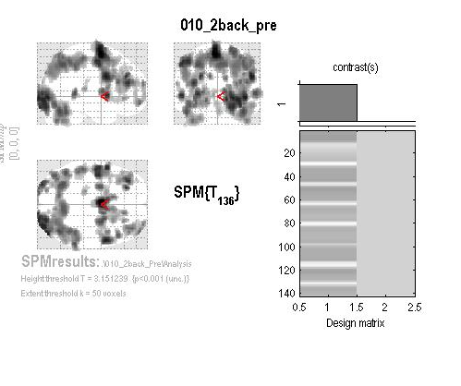
fMRI application: What regions are active?
Use General Linear Model on blood-oxygen-level dependent (BOLD) activity
Identify regions of interest (ROIs)
Notes:
BOLD – hemodynamic response of blood releasing oxygen to active neurons. We look at the blood-oxygen-level dependent activity.
Time series that we actually use has been processed to remove artifacts such as movement, physiological rhythms, etc. that are not related to research question thus their influence on variation is removed.
This is a block design.

Slide 9
fMRI application: How do regions work together
Structural Equation Modeling (SEM)
Vector Autoregression (VAR)
with Granger Causality
Unified SEM
Dynamic Causal Modeling (DCM)
Notes:
Effective connectivity attempts to identify the influence that one region might have on another.
For granger causality to exist, past information from one ROI must offer statistically unique contribution in explaining variance in a second ROI which is better than using the ROI to predict itself. Temporal ordering must be established
Important because it’s well established that fMRI BOLD data has serial dependencies
VAR accounts for bias introduced if we ignore autocorrelation in SEM
Unified SEM accounts for autoregression in SEM framework

Slide 10
Evolution of SEM for fMRI
SEM (McIntosh & Gonzalez-Lima, 1994)
η(t) = Bη(t) + e(t)
var[e(t)] diagonal
VAR(q) with Granger Causality (Goebel et al., 2003)
η(t) = Φ₁η(t-1) + … + Φ_{q}η(t-q) + ζ(t)
var[ζ(t)] full
Unified SEM (Kim et al., 2007)
η(t) = Aη(t) + Φ*₁η(t-1) + … + Φ*_{q}η(t-q) + ζ*(t)
var[ζ*(t)] diagonal
Notes:
Unified SEM (Kim et al., 2007)
Considers lagged and contemporaneous relationships among ROIs by combining VAR and traditional SEM
Error for instantaneous & unified SEM is diagonal, VAR = symmetrical
b/c variation among regions at the instantaneous time should be modeled through beta’s rather than correlation matrix
SEM: no autocorrelation explained, introduces bias
VAR: models autoregression and residual has full covariance matrix (standard factor autoregression covariance matrix for residuals)
USEM: A matrix explains directed contemporaneous relations; phi* is autoregression of lagged relationships; basis of GIMME

Slide 11
Equivalence VAR – unified SEM (Gates, Molenaar et al., 2010)
VAR(1): η(t) = Φη(t-1) + ζ(t)
var[ζ(t)] = full = (I – A)⁻¹ψ(I – A)^{-T}
ψ diagonal
(I – A)η(t) = (I – A)Φη(t-1) + (I – A)ζ(t)
(I – A)Φ ≡ Φ* and (I – A)ζ(t) ≡ ζ(t)*
uSEM(1) : η(t) = Aη(t) + Φ*η(t-1) + ζ(t)*
var[ζ(t)*] = ψ diagonal
Notes:
Var(1) obtained with Cholesky decomposition

Slide 12
Linear state-space model with arbitrarily time-varying parameters for replicated series (Molenaar, Beltz, Gates & Wilson, 2016)
y(t) = τ(t) + Λ[θ(t)]η(t) + v(t)
η(t+1) = α(t) + Β[θ(t)]η(t) + Γ[θ(t)]u(t) + ζ(t+1)
θ(t+1) = θ(t) + ξ(t+1)
y(t): Observed p-variate BOLD time series
η(t): Latent q-variate state process
u(t): Observed input series
θ(t): Supervector of all parameters
Notes:
Lambda is factor loading matrix and is function of theta(t) → time-varying
Algorithm determines which factor loadings are time-varying and in what way
Theta(t + 1) evolves based on random walk

Slide 14
Notes:
Several factor loadings were time varying

Slide 15
Some preliminary conclusions
Smith et al. (2011) showed that none of 28 effective connectivity mapping methods performed acceptably
GIMME yields almost perfect results when applied to the same large simulated data set
In addition GIMME is the only available approach to validly handle heterogeneous replications
When applied within a moving window scheme GIMME can handle nonstationary data

Slide 16
GIMME is a work in progress
Multiple common group models (Gates, Molenaar, et al., 2014)
A posteriori model validation (testing order of euSEM; Beltz & Molenaar, 2015)
Accommodating multiple solutions (Beltz & Molenaar, 2016)

Slide 17
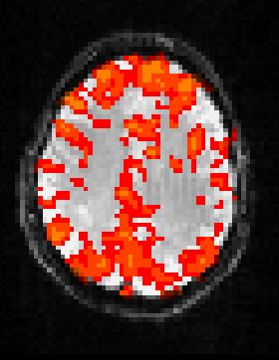
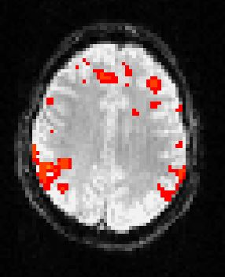
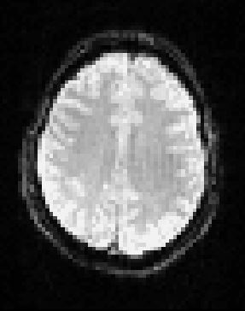
Non-stationarity
Connectivity may change over time
Especially during neural adaptation to task demands
Run 1
Run 2
Run 3
Cluster corrected p < .05;
hotter colors reflect higher z-values
Notes:
Could be developmental time, but could also be in the course of a scan session
Data show Win > Loss contrast on card task for FNCP subject 0006

Slide 18
TV-GIMME
Apply GIMME to single participant data
Group-Level = Constant in Time
Individual-Level = Time Varying
Inputs
Run 3
Run 1
Run 2
ROI 1
ROI 2
Run 1
Run 2
ROI 1
ROI 2
Run 3
ROI 1
ROI 2
group-level lag 1
individual-level concurrent
Individual-level lag 1
Notes:
Group level is stationary
Individual level is time-varying

Slide 19
What is GIMME?
An accurate way to explain temporal covariation in a system
Notes:
Simulations were in the neuroimaging literature, and the is the field in which GIMME originated; although GIMME can be applied to different types of data, you’ll likely notice the predominance of neuroscience applications

Slide 20
What is GIMME?
An accurate way to explain temporal covariation in a system
accurate
estimates person-specific models (with sample information)
according to large-scale simulations
Notes:
Simulations were in the neuroimaging literature, and the is the field in which GIMME originated; although GIMME can be applied to different types of data, you’ll likely notice the predominance of neuroscience applications

Slide 21
What is GIMME?
An accurate way to explain temporal covariation in a system
accurate
estimates person-specific models (with sample information)
according to large-scale simulations
temporal covariation
estimates directed lagged and contemporaneous relations
requires time series data
Notes:
Simulations were in the neuroimaging literature, and the is the field in which GIMME originated; although GIMME can be applied to different types of data, you’ll likely notice the predominance of neuroscience applications

Slide 22
What is GIMME?
An accurate way to explain temporal covariation in a system
accurate
estimates person-specific models (with sample information)
according to large-scale simulations
temporal covariation
estimates directed lagged and contemporaneous relations
requires time series data
system
relations among variables
nodes and edges in a network
Notes:
Simulations were in the neuroimaging literature, and the is the field in which GIMME originated; although GIMME can be applied to different types of data, you’ll likely notice the predominance of neuroscience applications

Slide 23
GIMME implements unified structural equation models (uSEMs)
.4
Variable 1
Variable 2
.4
.2
.6
η(t): observed time series
A: matrix of concurrent coefficients
Φ: matrix of lagged coefficients
ζ(t): errors, assumed to be white noise
Variable 3
.4
Contemporaneous (A)
Lag (Φ)
Gates et al. (2010); Kim et al. (2007)
Notes:
uSEMs are a type of structural VAR model, which means that they contain contemporaneous and lagged relations, but uSEMs are unique compared to other structural VARs in the way they are fit to the data (has to do with psi, which allows A and phi to be estimated simultaneously)
For this example, eta is 3 x 1, A is 3 x 3, phi is 3 x 3, and zeta is 3 X 1
Variable 3 at t influences Variable 1 at t + 1
Psi is covariance matrix at t and t + 1 (twice as many rows/columns as variables)
GIMME starts by fixing elements in Psi

Slide 24
uSEM in matrix notation
Φ and A coefficients depicted in the β matrix indicate candidate relations. They are not all included in the model.
Gates et al. (2010); Kim et al. (2007)
Notes:
Why bother with sparse matrices?
Full correlation matrices have been cited as producing unreliable results for network theory metrics (e.g., Marrelec et al.; 2006; Liu et al., 2009; Zalesky, Fornito, & Bullmore, 2012).
Partial correlation matrices may be too heavy handed by only including unique effects and partialling variability explained by all other variables.
Here we strike a balance by only controlling for effects which explains a statistically significant amount of variability in the target variable.

Slide 25
uSEM in matrix notation
Contemporaneous (A)
Lag (Φ)
.4
Variable 1
Variable 2
.4
.2
.6
How to decide which parameters are estimated?
Variable 3
.4
η_{2,t-1}
η_{3,t-1}
η_{2,t-1}
η_{3,t-1}
ζ_{2,t-1}
ζ_{3,t-1}
Φ_{1,1}=.4 . Φ_{1,3}=.6 . a_{1,2}=.2 .
. Φ_{2,2}=.4 . . . .
. . Φ_{3,3}=.4 . . .
η_{2,t}
η_{3,t}
η_{2,t}
η_{3,t}
ζ_{2,t}
ζ_{3,t}
Notes:
Could use a confirmatory approach is you have a priori hypotheses

Slide 26
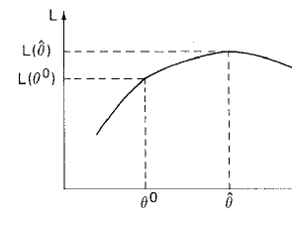
Model selection using modification indices (Lagrange Multiplier equivalents tests)
Modification Indices (MIs) are scores that indicate the expected change in likelihood from the null hypothesis to the alternative for each candidate parameter
Process of identifying best parameter to free repeats until the model fits well.
Log Likelihood
Null
Parameter Freed
Engle (1984); Sörbom (1987)
Notes:
Likelihood is the probability of the data, given the parameters estimates. We want to maximize this.
If LM is high, the hypothesis that the model with the extra parameter equals the null may be rejected
Lagrange Multiplier (LM) equivalent identifies which parameter, if freed, would maximally improve model fit.
Some criticisms of MI-based approaches, arguing that they capitalize on chance. Our simulations show that GIMME minimizes this (due to grouping) and we have other modeling approaches (e.g., multiple solutions) for handling this directly.
MI have asymptotic X^2 distributions
Generally, we use .75 cutoff for MI’s

Slide 27
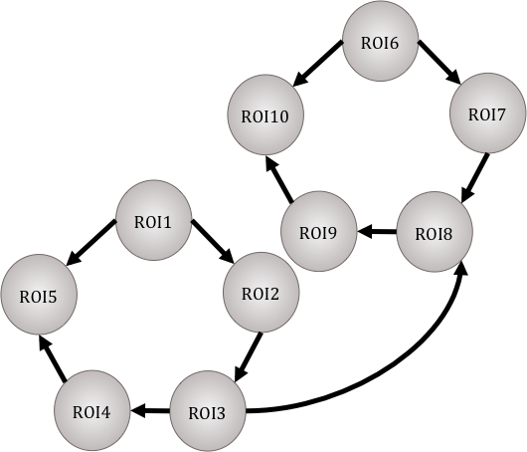
GIMME
RO16
ROI10
ROI7
Creates a group-level model using MIs in a way that only selects paths that improve most individual models.
Conducts model search for individual-level paths and estimates.
ROI1
ROI9
ROI8
ROI5
ROI2
ROI4
ROI3
Person A
Person B
Gates & Molenaar (2012)
Notes:
Indicate here that we know from previous work that starting with the group prior improves recovery of individual-level paths.

Slide 28
GIMME
η_{i}(t) = (A_{i} + A^{g})η_{i}(t) + (Φ_{i,1} + Φ₁^{g})η_{i}(t - 1) + ζ_{i}(t)
Gates & Molenaar (2012)
Notes:
uSEMs are a type of structural VAR, meaning that they estimate both lagged and contemporaneous relations among ROIs, but uSEMs have a unique estimation procedure that make them more accurate than other structural VARs

Slide 29
GIMME
η_{i}(t) = (A_{i} + A^{g})η_{i}(t) + (Φ_{i,1} + Φ₁^{g})η_{i}(t - 1) + ζ_{i}(t)
time series to be explained
Gates & Molenaar (2012)

Slide 30
GIMME
η_{i}(t) = (A_{i} + A^{g})η_{i}(t) + (Φ_{i,1} + Φ₁^{g})η_{i}(t - 1) + ζ_{i}(t)
Matrix of concurrent relations for the group and individual
Gates & Molenaar (2012)
Notes:
First phase of GIMME algorithm determines the group matrix Ag

Slide 31
GIMME
η_{i}(t) = (A_{i} + A^{g})η_{i}(t) + (Φ_{i,1} + Φ₁^{g})η_{i}(t - 1) + ζ_{i}(t)
Matrix of lagged relations for the group and individual
Gates & Molenaar (2012)

Slide 32
GIMME
η_{i}(t) = (A_{i} + A^{g})η_{i}(t) + (Φ_{i,1} + Φ₁^{g})η_{i}(t - 1) + ζ_{i}(t)
Error matrix lacking sequential dependencies
Gates & Molenaar (2012)

Slide 33


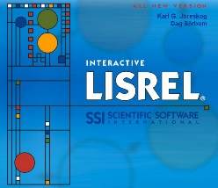
Fitting GIMME
Run empty, null GIMME.
According to Lagrange multiplier tests, will estimating a relation significantly improve model fit for a criterion (75%) of the sample?
Group-Level
Yes
No
Estimate the model after freeing the optimal relation for the sample.
Prune non-significant
group-level relations.
According to Lagrange multiplier tests, will estimating a relation significantly improve model fit for an individual?
Individual-Level
Yes
No
Estimate the model after freeing the optimal relation.
Prune non-significant
individual-level relations.
Gates & Molenaar (2012)
Assess model fit.
Notes:
uSEMs can be fit in any standard software containing MI estimation, but this grouping process is what has been programming into R and Matlab + LISREL.
Don’t have to start with null model, could specify specific connections to start with

Slide 34
Evaluating GIMME
Compared to 38 temporal network methods used in fMRI analyses
Undirected | Directed
Full Correlation | Granger A1 | DTF lag3
Correlation bandpass 1/2 | Granger A3 | DTF lag10
Correlation bandpass 2/8 | Granger A20 | Gen Synch S1
Partial Correlation | Granger B1 | Gen Synch H1
ICOV λ=5 | DC lag2 | Gen Synch S2
ICOV λ=100 | DC lag3 | Gen Synch H2
MI | DC lag10 | Patel's τ
Partial MI | GGC lag1 | Patel's τ bin0.75
Coherence A3 | GGC lag10 | CCD
Coherence B3 | PDC lag1 | CPC
Patel's κ | PDC lag3 | FCI
Patel's κ bin0.75 | PDC lag10 | PC
 | LiNGAM | GES
Smith et al. (2011)

Slide 35
GIMME wins!
% of True Adjacencies Identified
Simulation Conditions
Gates & Molenaar (2012)
Notes:
GIMME outperforms others – and individual-level uSEM – especially when data are noisey.

Slide 36
Access Program
Download R
Download and install following directions at https://www.r-project.org/
Get gimme
Freely available on CRAN: https://cran.r-project.org/web/packages/gimme/index.html
In R Console, install.packages(“gimme”, depen=T)

Slide 37
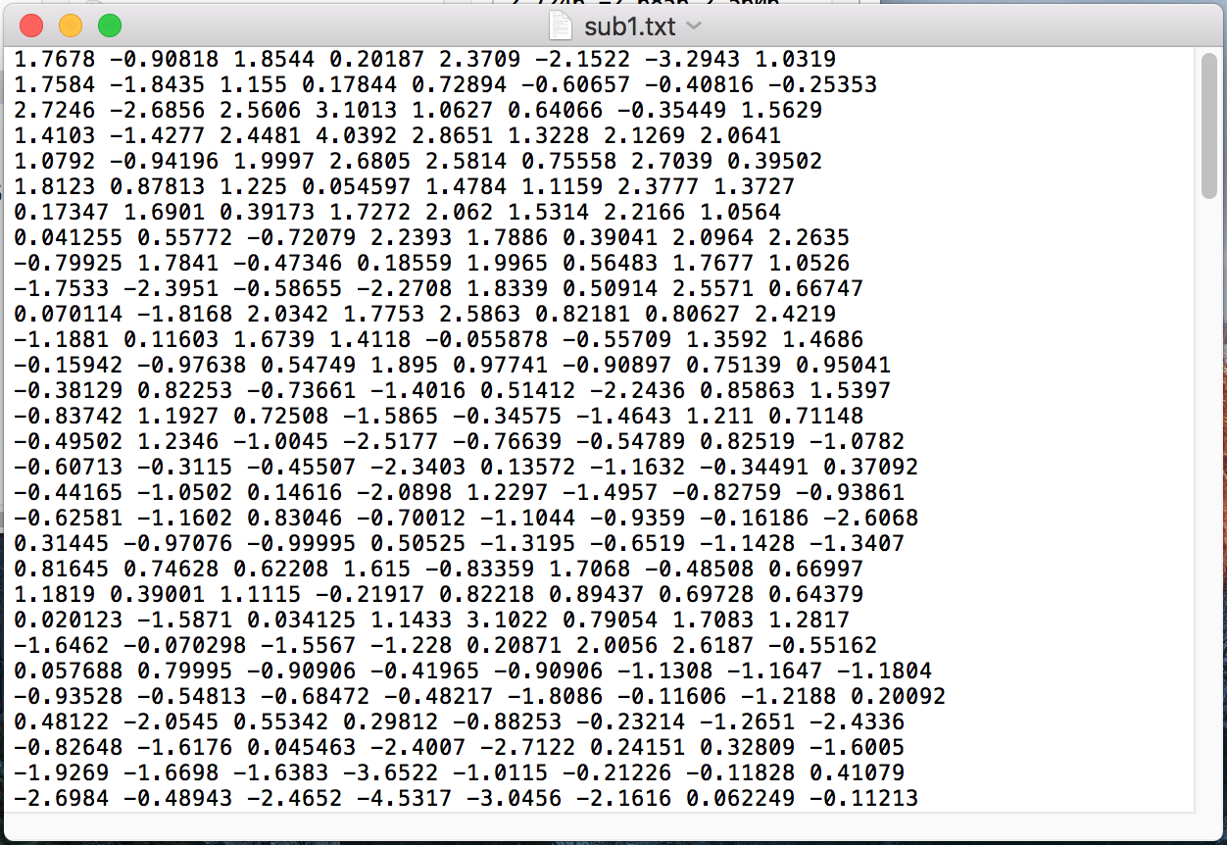
Access Data
https://sites.lsa.umich.edu/methods-hour/workshops
Simulated Data
play_data folder
N = 20 → each with file named sub#.txt
8 variables → columns in file
150 time points → rows in files
Notes:
One suggestion is at least 50 time points, Peter thinks 40 may be sufficient
Time points must be equidistant
GIMME can handle missing data

Slide 38
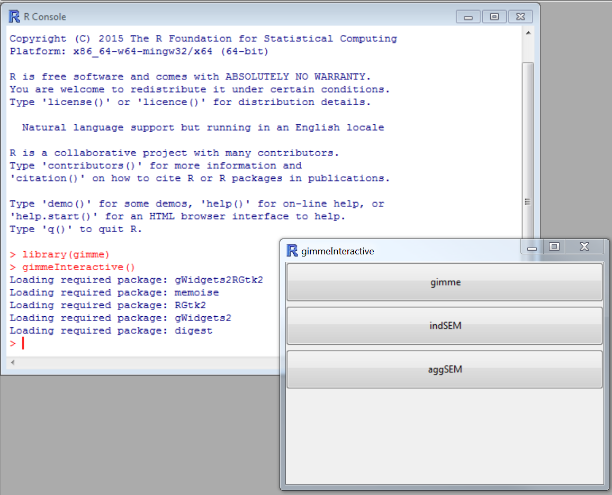
GIMME setup
1. Create a data folder
2. Create an output folder
3. Open R, and make sure these folders are in a searchable path
setwd(“C:/Users/abeltz/Desktop/workshop”)
4. Load GIMME
library(gimme)
5. Try to load GUI
gimmeInteractive()
Notes:
All of these instructions are in the GIMME manual that will come along with your download, so I’ll just mention them briefly here
The data and output folders can be called different things.
gimmeInteractive() is persnickety, so it’s okay if it doesn’t work for you.

Slide 39
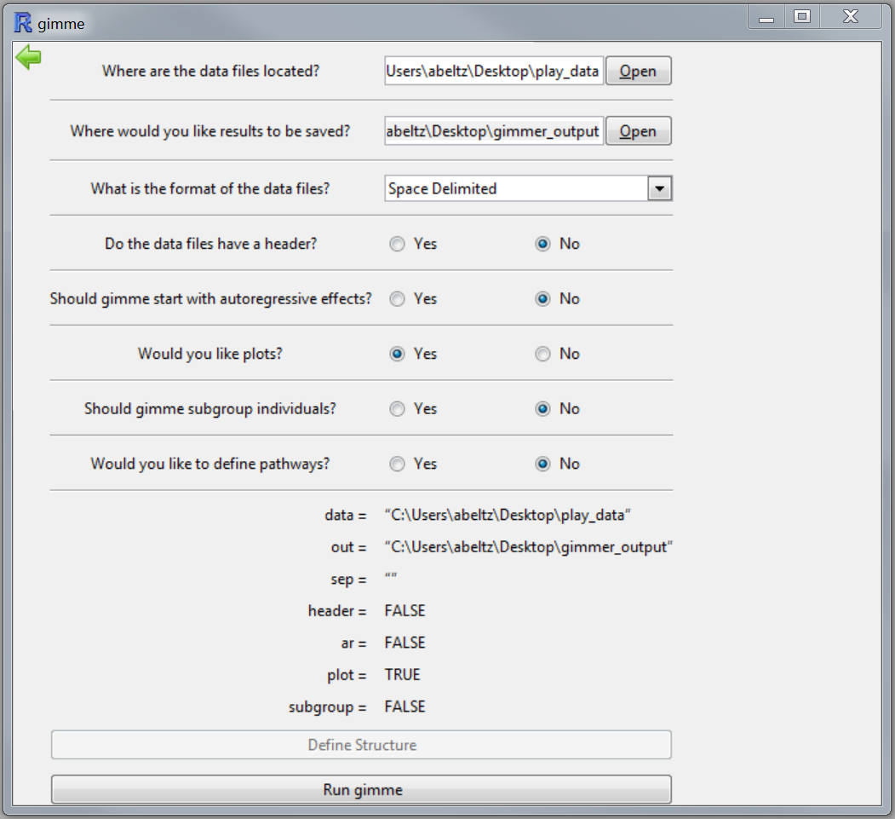
GIMME GUI

Slide 40
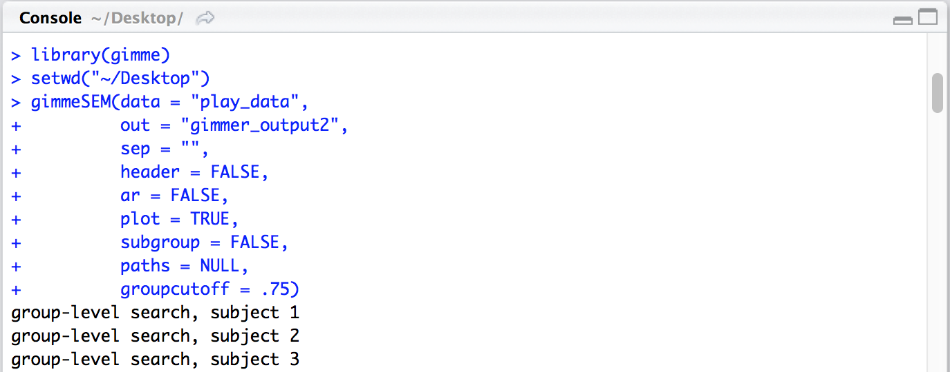
GIMME from R Console
Available in shared R script
data: Path to directory where data files are located.
out: Path to directory where results will be stored.
sep: Spacing of data files. “” for space-, “/t” for tab-, and “,” for comma-delimited.
header: TRUE for data files with headers.
ar: TRUE if gimme should begin search with autoregressive paths open.
plot: TRUE if plots should be included in output.
paths: lavaan- style syntax containing initial paths to begin model search.
groupcutoff: Criterion cutoff value for group-level paths; default = .75.
Notes:
Use gimmeSEM for full analysis. There is also aggSEM for group-level only, and indSEM for individual-level only.
Arguments can depend on downloaded version of gimme, as it was recently updated.
data: Each file must contain one matrix for each individual containing a T (time) by p (number of variables) matrix

Slide 41
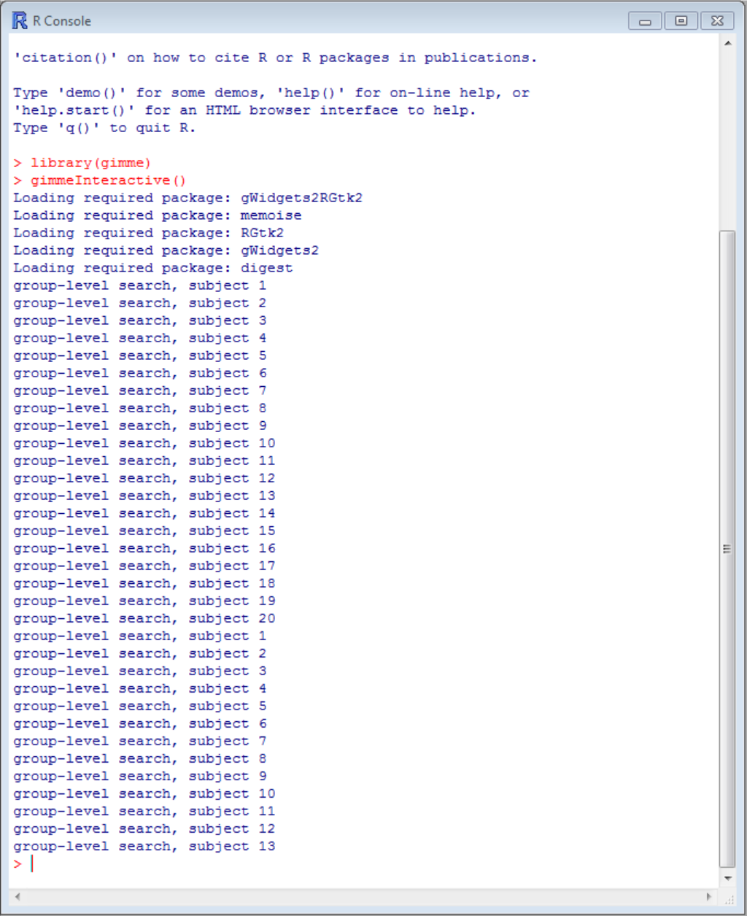
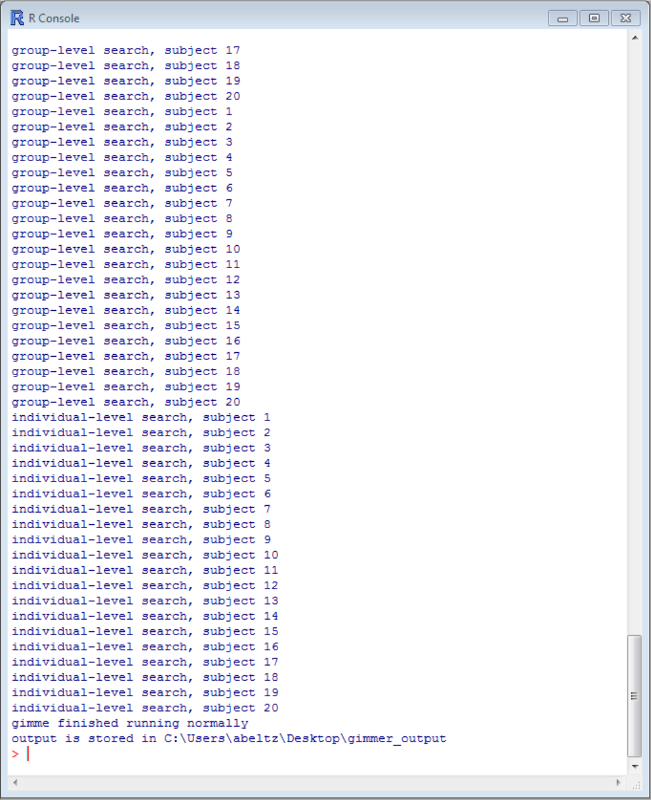
Feedback while GIMME runs
iterative group-level search
individual-level search
done

Slide 42
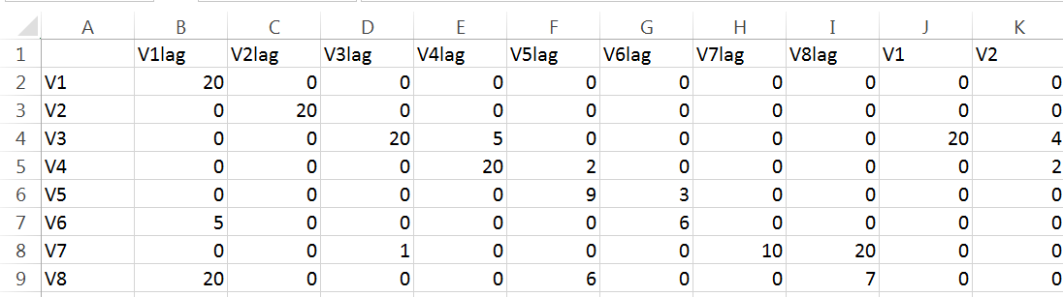
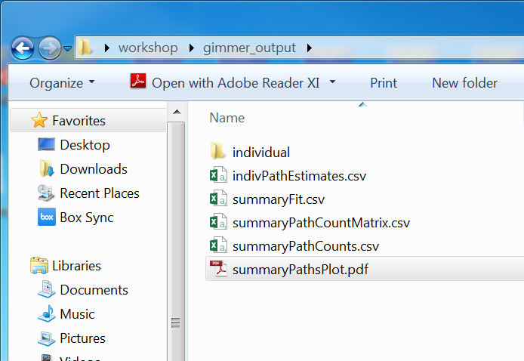
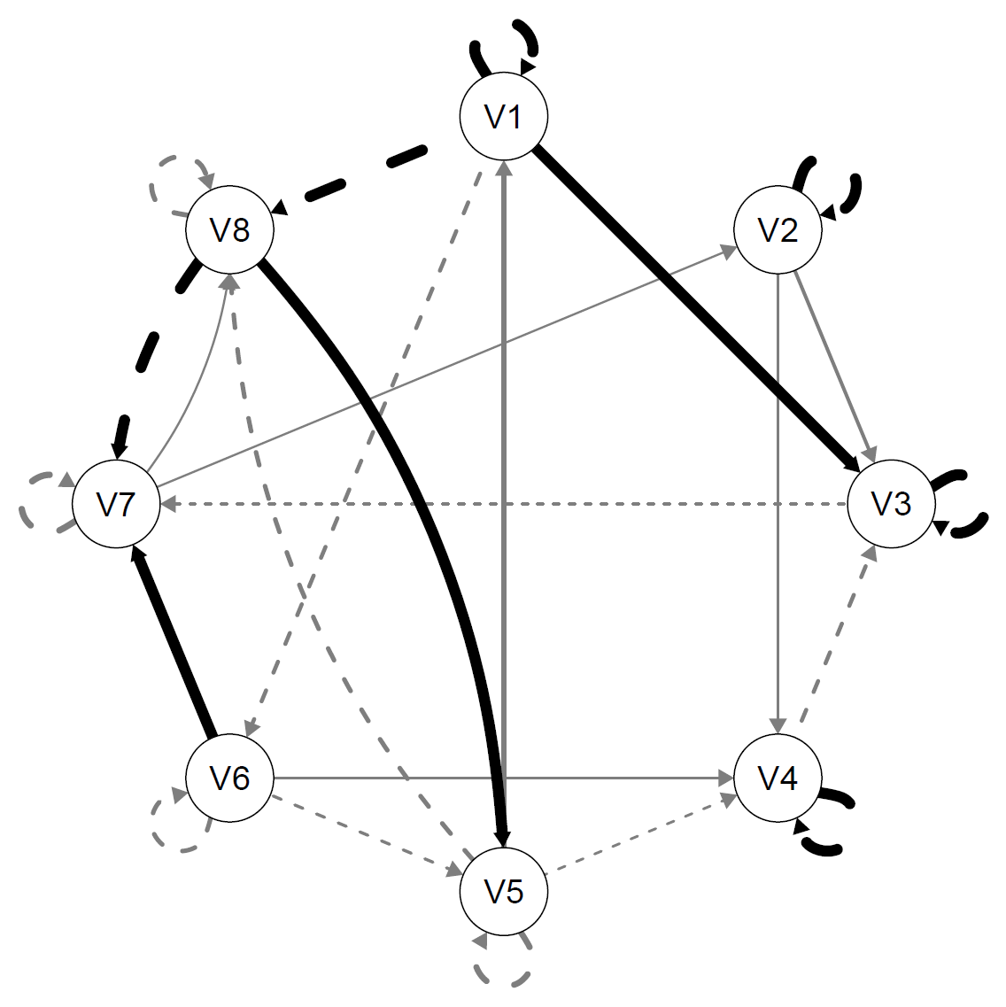
Summary output
SummaryPathCountsMatrix
Paths weighted by frequency of occurrence
individual concurrent
individual lagged
group concurrent
group lagged
Notes:
Numbers from which the map is generated come from the summaryPathCountsMatrix files.
Fit indices for each individual are in summaryFit.
indivPathEstimates contains beta values with significance tests for all paths estimated for all individuals. Much of this is broken down in the individual folder.

Slide 43
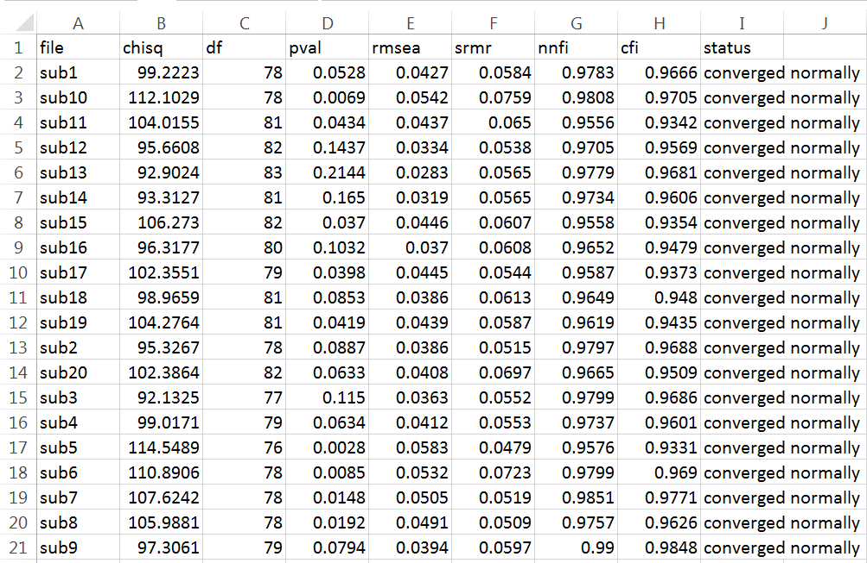
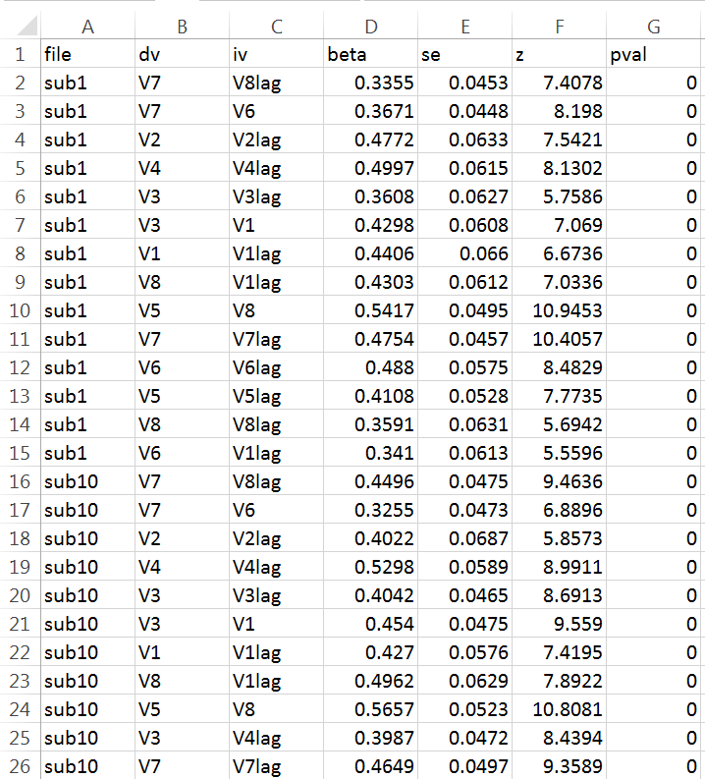
Individual-level output
SummaryFit
indivPathEstimates
Notes:
Numbers from which the map is generated come from the summaryPathCountsMatrix files.
Fit indices for each individual are in summaryFit.
indivPathEstimates contains beta values with significance tests for all paths estimated for all individuals. Much of this is broken down in the individual folder.

Slide 44
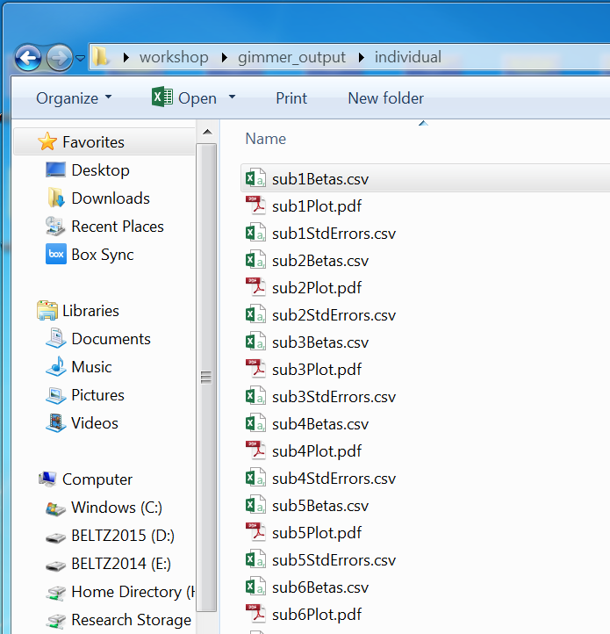
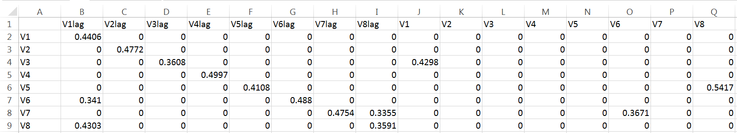
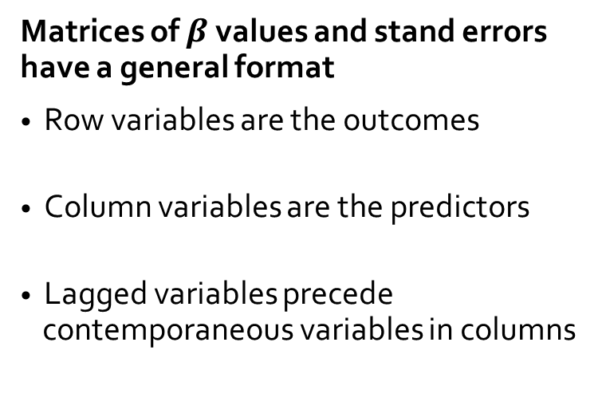
Individual-level output: matrices
Matrices of $β$values and stand errors have a general format
Row variables are the outcomes
Column variables are the predictors
Lagged variables precede contemporaneous variables in columns

Slide 45
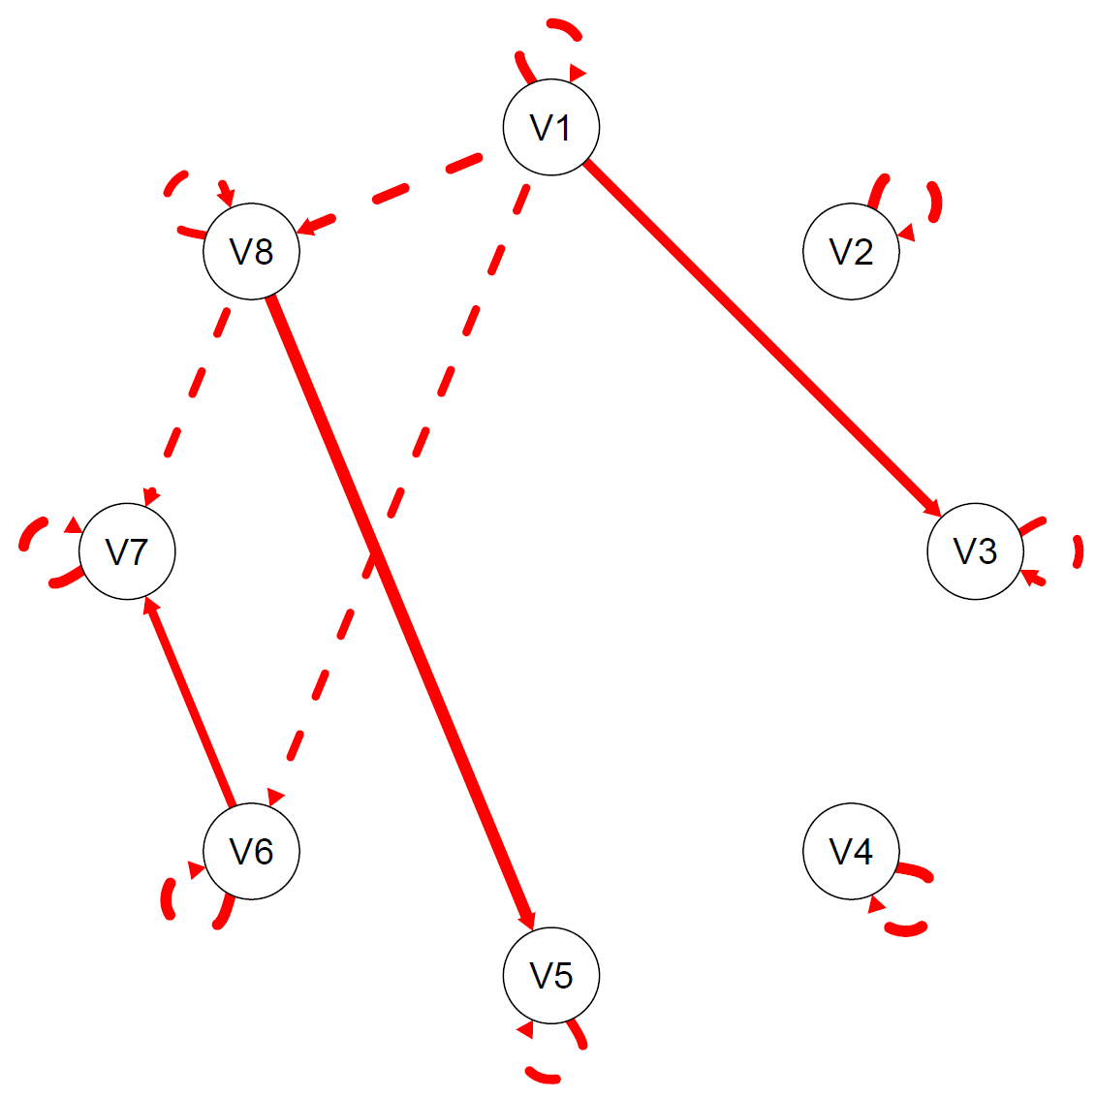
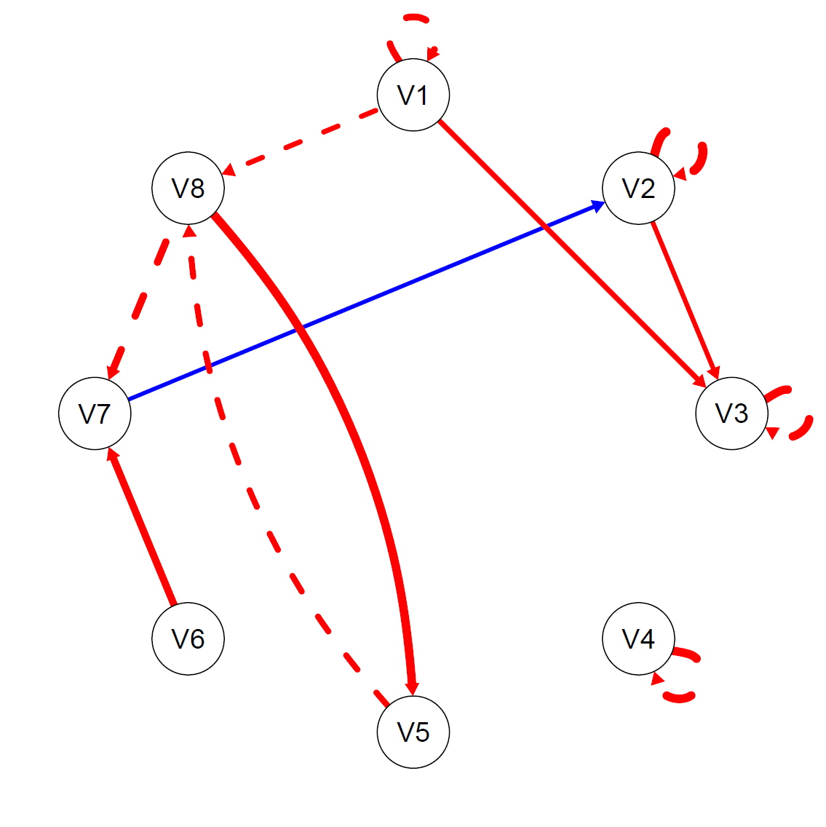
Individual-level output: plots
concurrent
lagged
positive
negative
Paths weighted by magnitude of beta
Notes:
ID1 (left): x2(78, N=150)=99, RMSEA=.04, SRMR=.06, CFI=.97, NNFI=.98
ID16 (right): x2(80, N=150)=96, RMSEA=.04, SRMR=.06, CFI=.95, NNFI=.97

